Slide 1

EE332 Course term project
GNU Radio SDR Receiver Design
Signal Parameter Estimation from Unknown Baseband Waveform
Problem Statement
A complex baseband signal is received using a PlutoSDR Source block. The transmitter details are not fully known at the receiver. Given only:
• Sampling Rate: 512,000 Hz (512 kHz)
Design a receiver flowgraph and estimate: Symbol Rate | Samples Per Symbol (SPS) | Frequency Offset (CFO) | Signal Constellation
Tested and verified with the attached IQ file (file37.iq) as input.
The receiver pipeline begins by capturing baseband IQ data through the PlutoSDR Source block at a fixed sampling rate of 512 kHz. The signal is then passed through a series of estimation blocks, each responsible for extracting one unknown parameter.
Varupula Tejaswini | Roll No: 230102103
Notes:
1

Slide 2
Receiver Design Procedure
Load IQ File
CFO Estimation
1
File Source block reads file37.iq at 512 kHz sampling rate. Complex IQ samples are streamed as 32-bit float pairs representing in-phase and quadrature components.
4
Peak frequency at q·Δf is located after raising signal to q-th power. CFO is calculated as Δf = peak_freq / q using FFT analysis
Estimate Symbol Period
CFO Correction (De-rotation)
2
FFT of |x|² reveals periodic peaks tied to the baud rate. Symbol rate is identified from peak frequency; SPS = Fs / symbol_rate.
5
Signal is multiplied by exp(−j2π·Δf·t) to remove frequency offset. This realigns the constellation to ideal phase positions before decoding.
Identify Constellation Order (q)
Decode & Save Bits
3
Signal is raised to power q and FFT is computed. A sharp DC spike at q = 8 confirms the 8-PSK modulation order blindly
6
Each symbol is mapped to its nearest constellation point and converted to binary. Repacked bits are written to output.bin via File Sink block.
Notes:
2

Slide 3
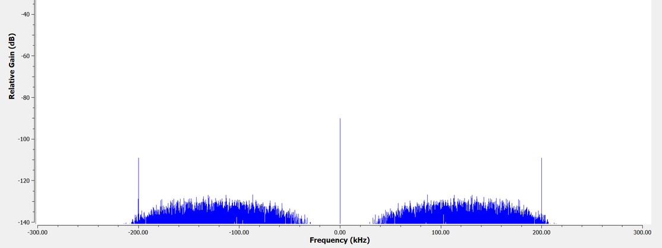
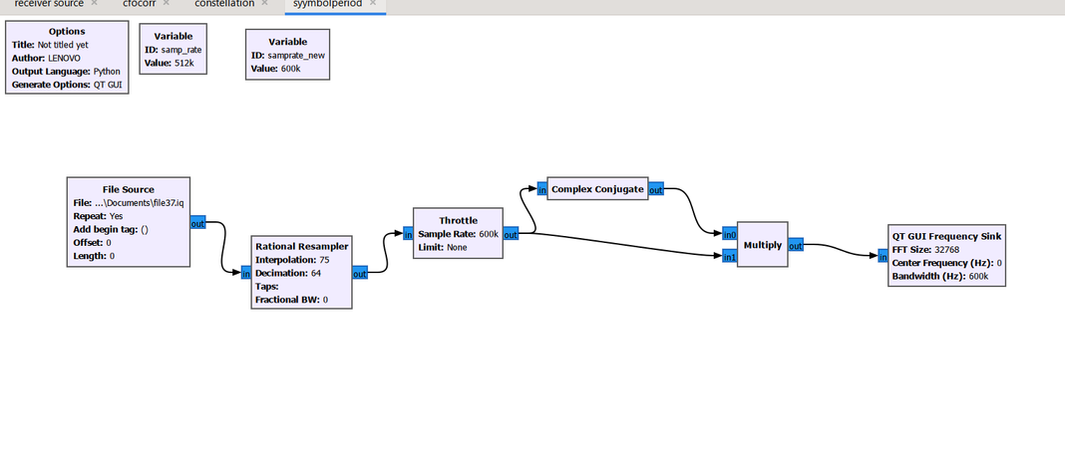
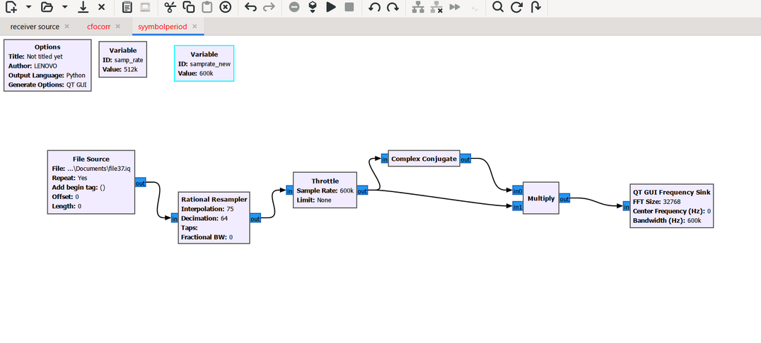
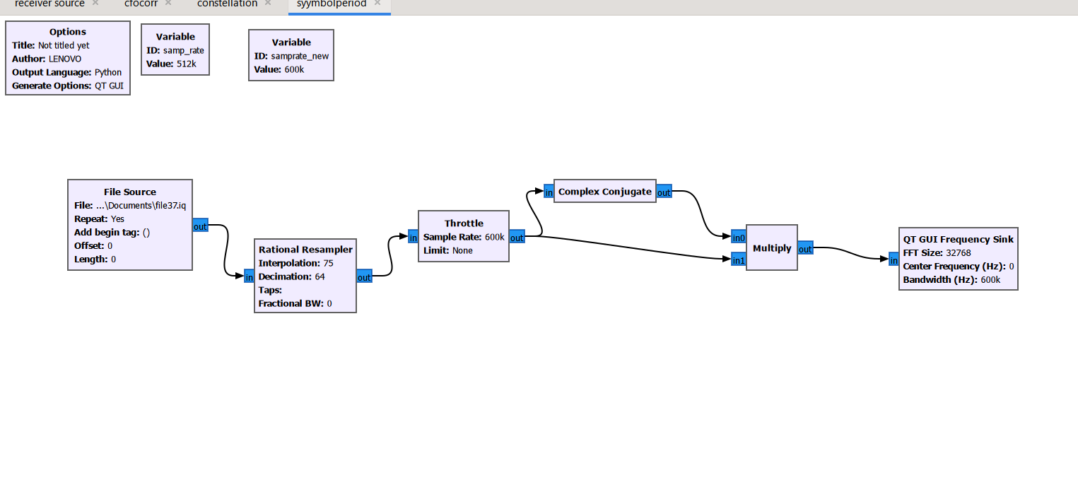
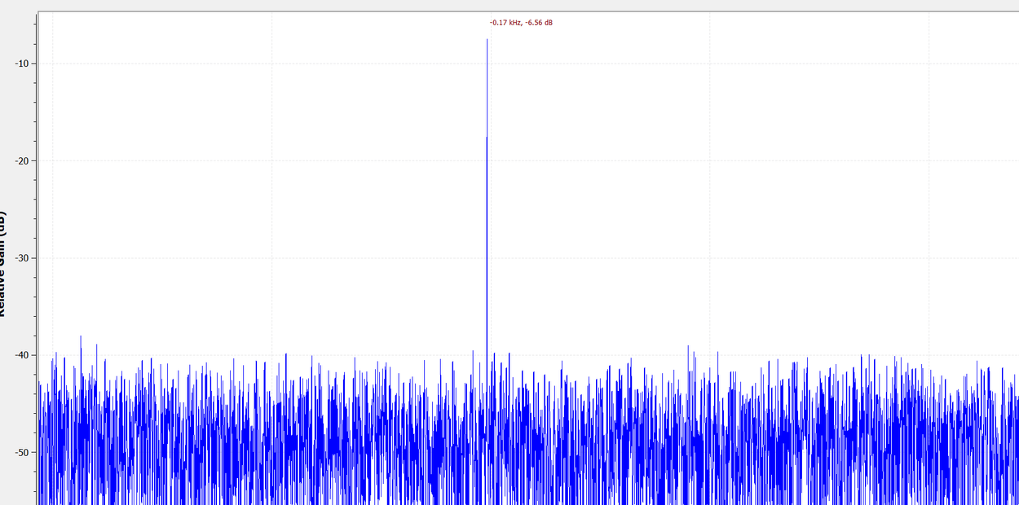
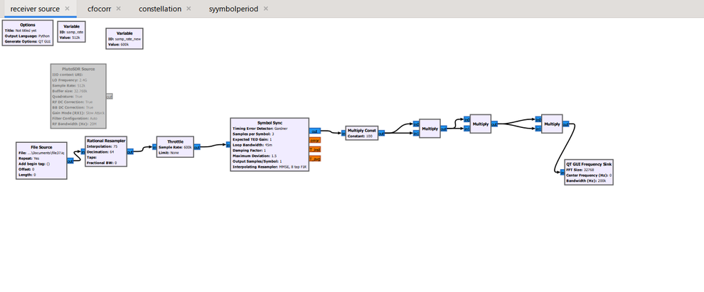
Estimation Plots
Symbol Period Estimation
Symbol period flowgraph
FFT of |x|² → Peak at symbol rate frequency,peak at 200kHz ,symbol rate=200kHz
CFO Estimation
CFO Estimation flowgraph
Peak at q·Δf =-0.172 kHz → Δf = peak / 8 =-21.55Hz ,Signal raised to power q=8 → 8-PSK confirmed.
Notes:
3

Slide 4
GNU Radio Flowgraph — Block Descriptions
File Source
Rational Resampler
Reads file37.iq; provides raw complex IQ samples at 512 kHz input sampling rate.
Interpolation 75, Decimation 64 → resamples to 600 kHz to match processing chain.
Throttle
Multiply + Float-to-Complex
Limits sample rate to 800k to prevent CPU overload during file-based simulation.
Cosine & sine sources (Freq: 21.55 Hz) synthesize a local complex exponential for mixing.
Root Raised Cosine Filter
Symbol Sync
Matched filter: 600k sample rate, 200k symbol rate, Alpha 350m, 29 taps — reduces ISI.
Gardner TED, SPS=3, Loop BW 45m, Damping 1, MMSE 8-tap FIR — recovers symbol timing.
Costas Loop
Constellation Decoder
Phase-frequency tracking, loop BW 30m, order 8 — corrects residual carrier frequency offset.
Decodes 8-PSK symbols using defined constellation object (8 points, soft decision precision 8).
Repack Bits
File Sink / GUI Sinks
Converts 3 bits/input byte to 8 bits/output byte for proper binary file formatting.
File Sink saves output.bin. Freq & Constellation sinks display live spectrum for verification.
Notes:
4

Slide 5
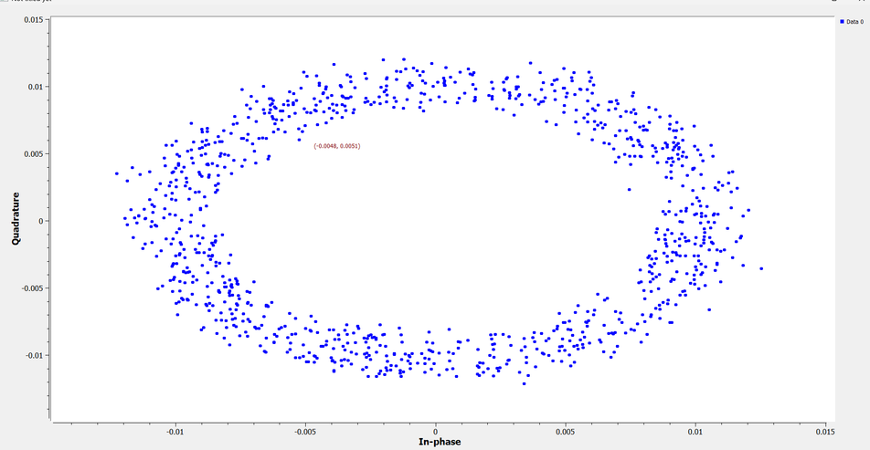
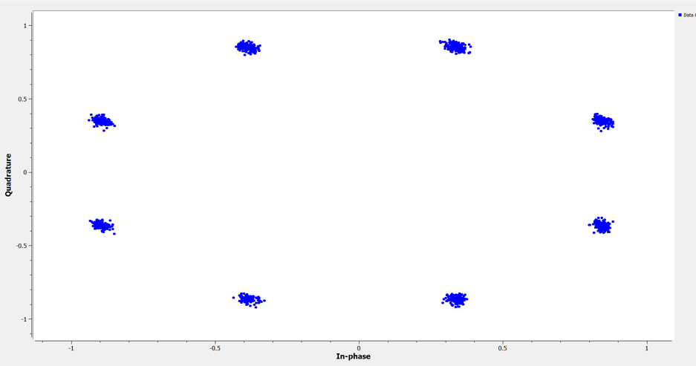
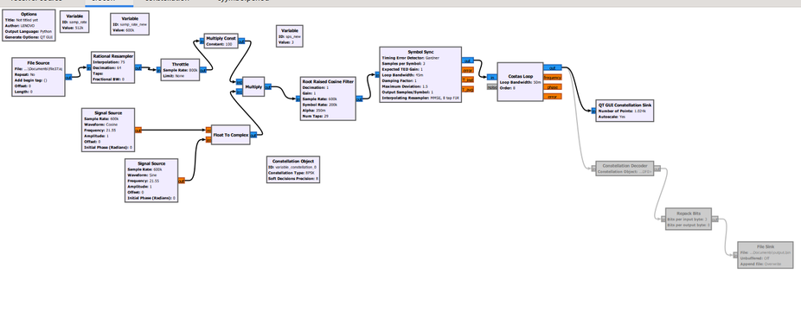
Constellation Plots & Conclusion
Before CFO Correction(without costas loop)
After CFO Correction
→
CFO
Correct
CFO correction flowgraph
Conclusion
A GNU Radio receiver flowgraph was designed to blindly demodulate an unknown 8-PSK signal using PlutoSDR at 512 kHz sampling rate. Key parameters were estimated from the received IQ waveform:
Symbol Rate: ~200 kHz | SPS: 2.56 → resampled to 3 | Modulation: 8-PSK | CFO: −21.55 Hz
A Rational Resampler corrected the sampling rate from 512 kHz to 600 kHz, yielding an integer SPS of 3. CFO correction at −21.55 Hz aligned the constellation to distinct 8-PSK phase points and the recovered bitstream was saved to output.bin
Notes:
5

